Slide 1
Model Predictive Control Based Jumping of Robotic Leg on a Particular height using Reinforcement Learning
Presented by :
Amrita Rai
DBUU
1

Slide 2
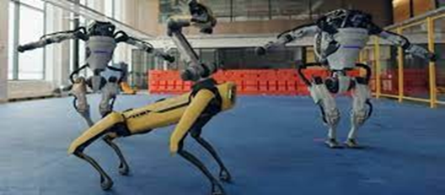
Introduction
Robots are essential to the study of physics because they can perform tasks that humans are unable to.
We are specifically referring to space robots, which have the ability to live in space, transport supplies for space missions, monitor space stations, or just stroll on the earth so that people may view these locations from a distance.
An industrial robot is a versatile manipulator that can be autonomously controlled, reprogrammed, and programmed in three or more axes.
Figure 1: Boston Robots
4

Slide 3
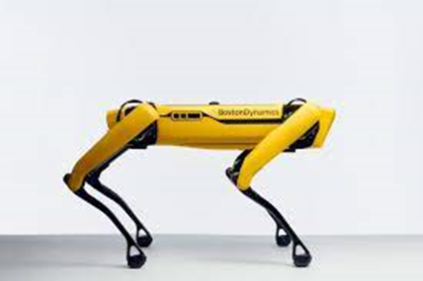
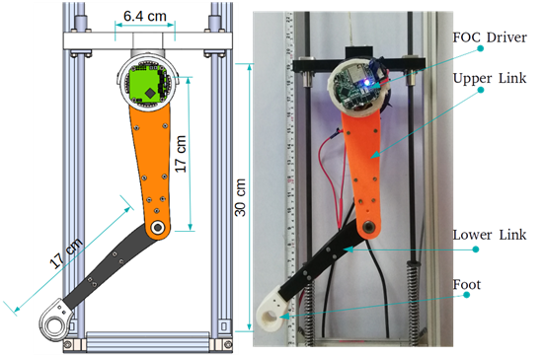
Introduction
Robotics:
Robotics is the science and technology of robots, their design, manufacturing and application.
Robotics develops machines that can substitute for humans and replicate human actions.
Figure 2: Spot Figure 3: Bob(Car)
5
[1] https://robots.ieee.org/robots/minicheetah/
[2] https://www.giantfreakinrobot.com/sci/robot-cheetah.html

Slide 4
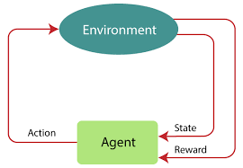
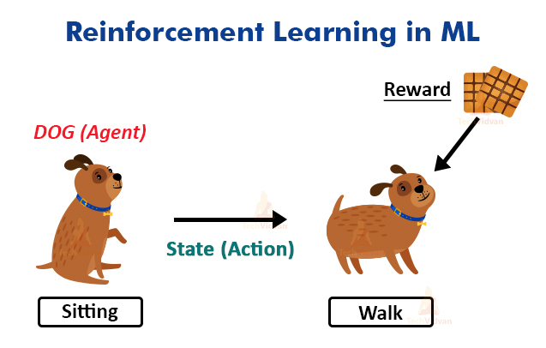
Introduction
Reinforcement Learning : An agent in environment who learn from there action and try to get cumulative rewards.
Figure4: Reinforcement Learning
Figure5: A sitting dog (agent) want to walk ,
for this he will get biscuits as a reward.
6

Slide 5
Different project stages and outputs
Stage 1:Project Initiation and Planning
1.Creating Questionnaires
Develop a set of questions focused on understanding the requirements, expectations, and potential applications.
Target audience: colleagues, industry experts, potential users, and academic mentors.
Plan to circulate the questionnaire via online forms or email, gather responses, and analyze them for insights.
2.Stakeholder Analysis
Stakeholders: Robotics engineers, project sponsor, researchers, potential end-users (e.g., medical/industrial robotics users).

Slide 6
Roles:
Robotics Engineers: Develop and optimize the robotic leg.
Sponsor: Provide funding and define project goals.
Researchers: Guide the use of MPC and RL methodologies.
End-users: Provide insights into usability and performance needs.
Relationships:
Collaborative relationship between engineers and researchers.
Sponsor oversees progress and resources.
Feedback loop with end-users to improve usability and effectiveness.
3.Defining Business Goals and Target Users
Business Goals: To develop a high-precision robotic leg that can jump to a specified height with optimized control and adaptability.
Target Users: Researchers in robotics, companies developing prosthetics, robotics teams in the manufacturing sector.

Slide 7
4.Project Challenges
Precise control over jump dynamics.
Integration of MPC and RL for real-time response.
Minimizing energy consumption and computational requirements.
5.Practical Need
Provides a practical solution for applications requiring high precision and adaptive control in robotics, such as in prosthetics, manufacturing robots, and search-and-rescue robots.
6.Differentiation from Competitors
Emphasize integration of MPC and RL for improved adaptability and response time.
Focus on minimal energy usage, precise control, and height accuracy.
Output: Project charter, stakeholder analysis document, initial questionnaires, and list of project goals.

Slide 8
Stage 2: Risk Management and Solution Design
1.Risk Identification and Mitigation Strategies
Risks:
Technical complexity of combining MPC and RL.
High computational load could impact response time.
Scope creep from stakeholders wanting additional features.
Solutions:
Use modular design for flexibility.
Employ efficient algorithms to reduce computation.
Regular scope reviews with stakeholders.
2.Scope Management
Define the scope clearly with stakeholders and document any additional requests formally.
Implement scope control mechanisms to prevent project delays.

Slide 9
3.Failure Avoidance
Regular testing and iteration during development.
Use of simulations to test control mechanisms before physical implementation.
Output: Risk management plan, scope document, and solution design document.
Stage 3: Technology Selection and Comparison
1.Investigation of Available Technologies
Evaluate existing MPC and RL frameworks.
Assess hardware options for the robotic leg that support adaptive control.
2.Technology Comparison
Compare different RL algorithms (e.g., Q-learning, Deep Q Networks) based on training time and control precision.
Evaluate hardware options based on processing power and weight.

Slide 10
3. Chosen Technology Justification
MPC for precise control over jump dynamics.
RL for adaptability to varying conditions and heights.
Output: Technology evaluation matrix, selection report, and justification document.
Stage 4: System Architecture and Breakdown Structure
1.Problem Breakdown and Solution Design
Components:
Jump control algorithm (MPC).
Adaptive learning model (RL).
Feedback mechanisms for real-time adjustments.
Resources: Software libraries, simulation tools, testing environment.
Team Roles: Developers for coding, testers for simulations, analysts for data interpretation.

Slide 11
2. Importance of Technology and Best Practices
Best practices in using MPC and RL.
Importance of simulation testing before real-world deployment.
Output: System architecture diagram, work breakdown structure, and technology best practices document.
Stage 5: Project Goals and Success Criteria
1.Defining Clear Goals
Accurate height achievement for each jump.
Reliable control response with minimal delay.
Robustness to environmental variations.
2. Success Criteria
Achievement of specified height within margin of error.
Low power consumption during operation.
Real-time response to varying conditions.

Slide 12
Output: Goals and success criteria document, KPI definition.
Stage 6: Project Metrics and Business Case Alignment
1.Measurements and Metrics
Jump height accuracy.
Response time (latency) for control adjustments.
Power consumption per jump.
2.Vital Business Functions
Reliability: Ensuring consistent jump height.
Efficiency: Minimizing energy usage.
Adaptability: Ability to adjust to new heights or conditions.
Output: Metrics document, report on business functions and alignment with business case.

Slide 13
Stage 7: Release and Deployment Plan
1.Objectives and Outcomes
Deliver a prototype capable of controlled, consistent jumps.
Provide documentation on MPC and RL integration.
2.Deployment Steps
Testing in controlled environments.
Release plan to stakeholders, including feedback collection.
Documentation and user manual for future reference.
Output: Deployment plan, prototype release notes, and user manual.
Stage 8: Learning Outcomes and Personal Development
1.Learning Statement
Key learnings from the integration of MPC and RL.
Enhanced understanding of adaptive control systems.

Slide 14
2. Current Capabilities and Development
Improved technical skills in control systems.
Knowledge of risk management and iterative testing.
3.Team Contribution
Individual contributions to each stage.
How knowledge gained will aid future projects and team activities.
Output: Learning outcomes document, personal development report, and team contribution summary.

Slide 15


